Slide 1

Source, Design & Plan a Gold Price System
Devin Datt, PMP
June 5th, 2019

Slide 2
Objectives
1) Create a combined dataset (gold, oil,..20 yrs)
2) Design dataset to update automatically
3) Blueprint a data warehouse for other sources

Slide 3
Objectives
1) Create a small dataset
Decide on data source – support of API
Decide on datasets to pull from
Code it
Discuss issues

Slide 4
Creating the Dataset
Decide on data source – support of API
IEX
Alpha Vantage
Quandl
Yahoo Finance
Stock Market Data

Slide 5
Creating the Dataset
Decide on data source – support of API
IEX
Alpha Vantage
Quandl
Yahoo Finance
Stock Market Data

Slide 6
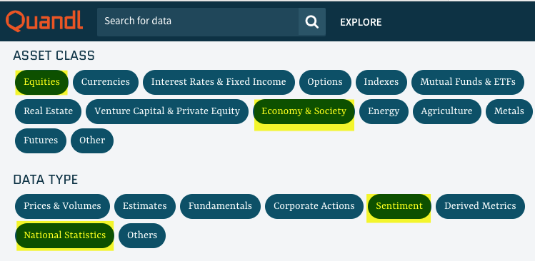
Creating the Dataset
Quandl API’s
Premium & Free
One stop shopping
10,000’s dataset:
financials, fundamentals, economic, industry data, news, social & sentiment data
Updates - few hours (daily data), 3 days (weekly data)

Slide 7
Creating the Dataset
Data sets pulled from:
Gold prices:
London Bullion Market Association: London Fixing (‘LBMA/GOLD’)
US GDP:
US Federal Reserve : Gross Domestic Product (‘FRED/GDP’)
US Unemployment rate
US Federal Reserve : United States Misery (‘USMISERY’)
Oil prices
OPEC : OPEC Crude Oil Price (‘OPEC/ORB’)

Slide 8
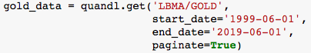
Creating the Dataset
Code it up
Code in a Jupyter Notebook:
https://github.com/devindatt/gold-spot-analysis
Pull datasets from previously mentioned API’s
Slight cleaning of columns, renaming…etc.

Slide 9
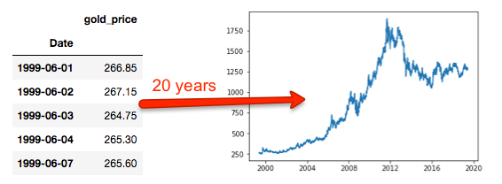
Creating the Dataset
Calls to API:
Repeat for the other data sources

Slide 10
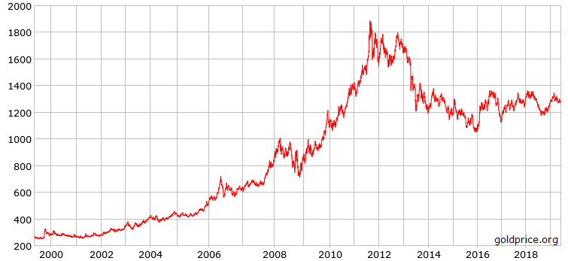
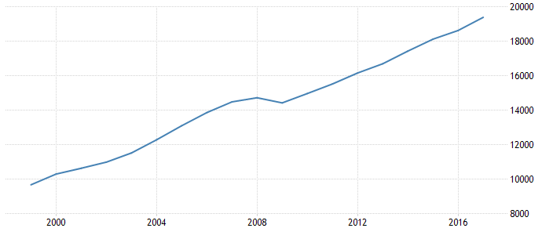
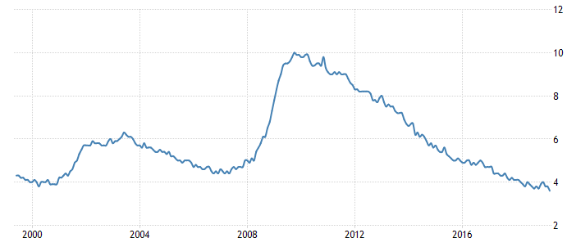
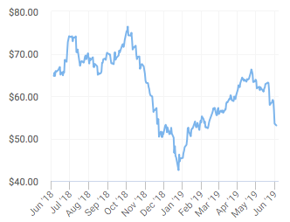
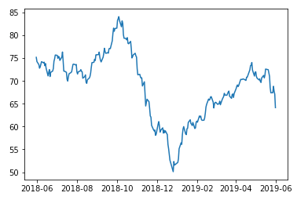
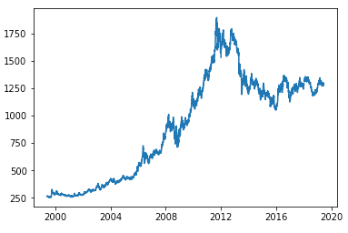
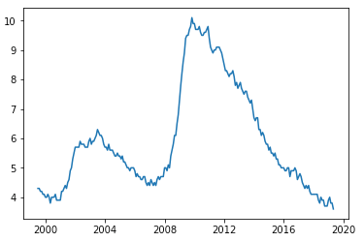
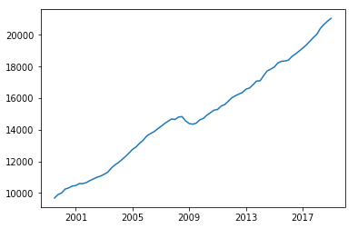
Creating the Dataset
Comparison of chart data for verification
Gold
GDP
Unemployment
Oil

Slide 11
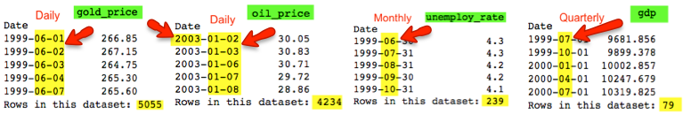
Creating the Dataset
Datatypes issues:
Data has different decimal places – issue?
GDP – 3 decimals
Date in different time series formats

Slide 12
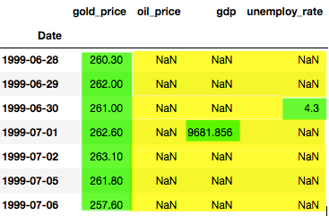
Creating the Dataset
Merged into one dataset
Outer JOIN
daily
daily
qtrly
mthly

Slide 13
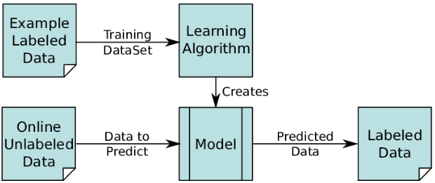
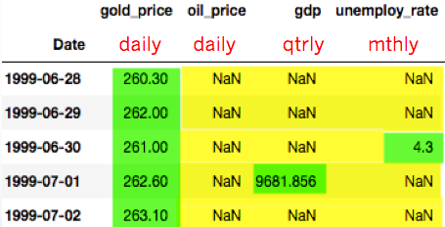
Creating the Dataset
How will this training model perform?
Use X features ~ gdp, oil, unemployment to predict y label (gold)
Label
Features

Slide 14
Creating the Dataset
Issues Encountered:
Not sure of the API linked to the correct data required
No webscraping – time contraints
Different time scales (daily, monthly, quarterly)
Discuss later

Slide 15
Creating the Dataset
Need to deal with missing values in merge data
Fillna – with forward or backward fill
Which method to use for aggregation?
Average, Min, Max, Mean, or Median
ARIMA – to use whole dataset to predict missing values
Leave it blank – fill zeros

Slide 16
Creating the Dataset
How to deal with missing data?
Need to decide on time granularity
What interval of data is absolutely need?
10, 20 years?
Oil data source didn’t provide data past 2003

Slide 17
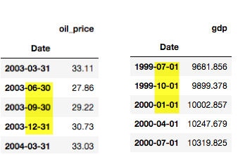
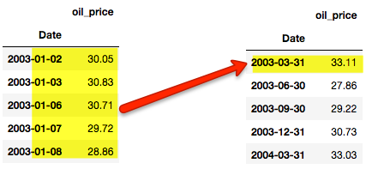

Creating the Dataset
How to deal with missing data?
How to implement
Can use ‘resampling’
Still not exactly the same!

Slide 18
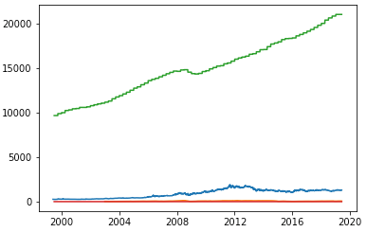
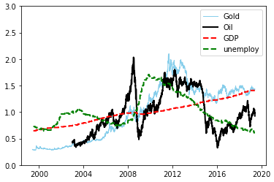
Creating the Dataset
Let’s visualize this data?
Normalizing the data:
Before Normalization
After Normalization

Slide 19
Objectives
1) Create a combined dataset (gold, oil,..20 yrs)
2) Design dataset to update automatically
3) Blueprint a data warehouse for other sources

Slide 20
Dataset Updating
How to update for new data?
Python script.py for ETL steps
Can live on prem server or cloud (ie. AWS EC2)
Make the duration of captured date flexible
Date of last upload
Calculate incremental interval
Use a scheduler (Linux cron job, Glue, Airflow)
Run batch process (D, M, Q) … depends on requirements

Slide 21
Objectives
1) Create a combined dataset (gold, oil,..20 yrs)
2) Design dataset to update automatically
3) Blueprint a data warehouse for other sources

Slide 22
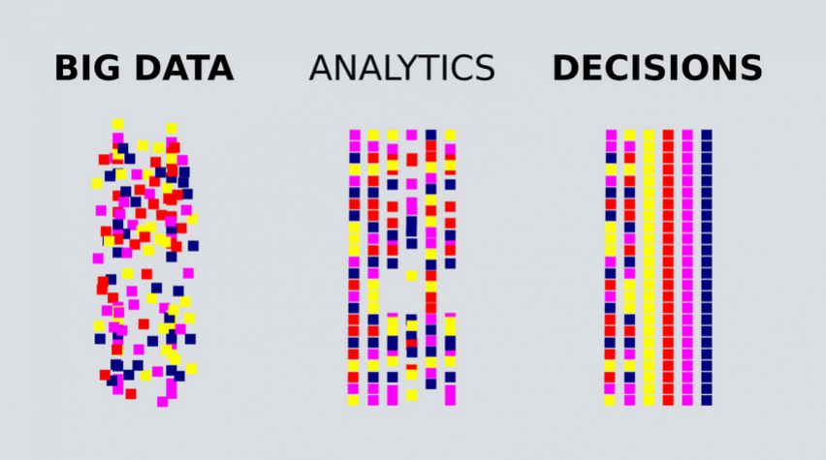
Big Picture

Slide 23
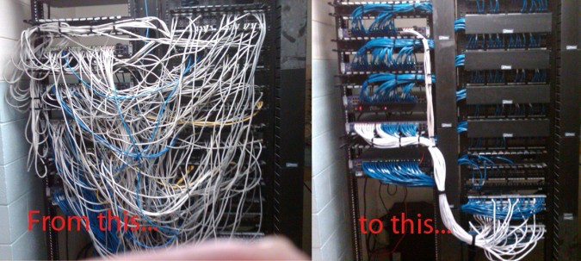
Mess to Clean

Slide 24
Objectives
Blueprint a data warehouse
SSA for any new sources
Which type of ETL Warehousing?
Suggestions for other sources

Slide 25
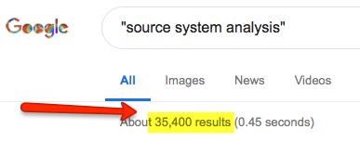
Blueprinting A Warehouse
SSA for any new sources
Source System Analysis (big topic)
Identify data quality issues in your data sources
Correct any issues before you integrating data into your services (or models)
Continually monitor quality of data governance
Product: IBM InfoSphere MDM

Slide 26
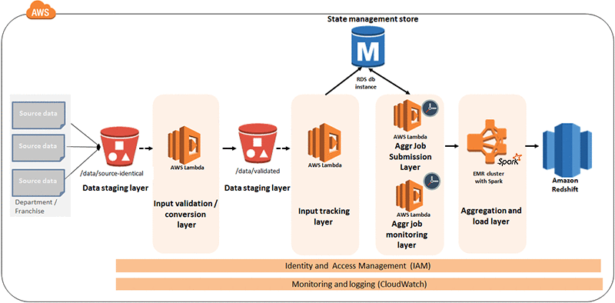
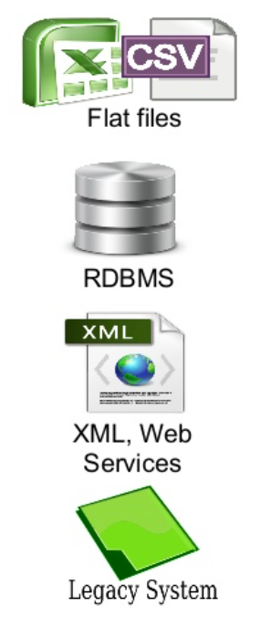
Blueprinting A Warehouse
Which type of ETL Warehousing?
Option 1: Create for tomorrow
Full ETL and data warehouse in the cloud

Slide 27
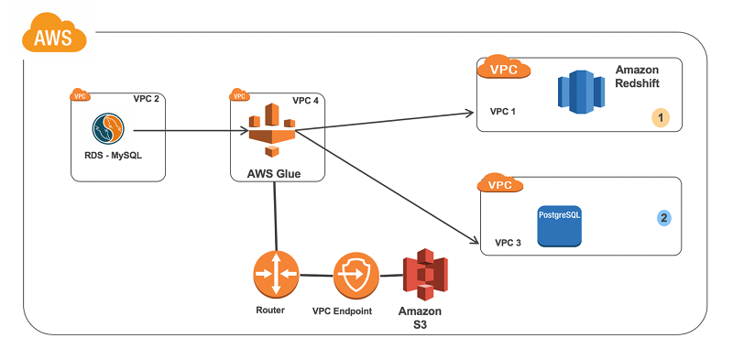
Blueprinting A Warehouse
Which type of ETL Warehousing?
Option 2: Create for todays needs
Simple ETL into standard Postgres DB for analysis

Slide 28
Blueprinting A Warehouse
Suggestions for other sources
India - large consumers of gold (25%)
Festive and wedding seasons, leading to gold rallies
World Gold Council – income & gold price
“1% inc. in income per capita gold demand rises by 1%”
“1% inc. in gold price, gold demand falls by 0.5%”
Volatility Index
People seem to flock to gold in times of uncertainty

Slide 29
Blueprinting A Warehouse
Suggestions for other sources
Inflation Index
High inflation people tend to hedge investments with gold
Interest Rates
Seems to be a negative coloration with gold prices
Monsoon Season
Rural India accounts for 60 percent of the country's consumption
Good season, good crops → farmers buy gold for investments
Bad season, low yield → farmers sell gold to generate funds

Slide 30
Blueprinting A Warehouse
Suggestions for other sources
Geo Political Sentiment
Demand for gold goes up as a safe haven for parking funds
Eg. Turmoil in the crisis over Korea's nuclear capability has boosted the price of gold
US Dollar
Gold and the USD share an inverse relationship
When USD starts fall, investors look for other investments sources

Slide 31
Blueprinting A Warehouse
Using NLP ETL Pipelines for Sentiment
Text Processing
Feature Extraction
Modeling
Software toolkits:
NLTK, Sci-kit Learn, Stanford CoreNLP
Web Services (via APIs)
IBM Watson, MS Azure, TweetSentiment

Slide 32
Let’s Talk Cloud!

Slide 33
Cloud Suggestions
AWS data services can be broken down into:
1) Ingestion, transfer, migration, API
2) Storage, caching, archival, backups
3) Query, catalog, search, process, reporting
4) Analytics, ML, DL

Slide 34


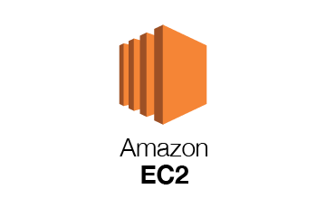


AWS Regular Services
The usual suspects

Slide 35
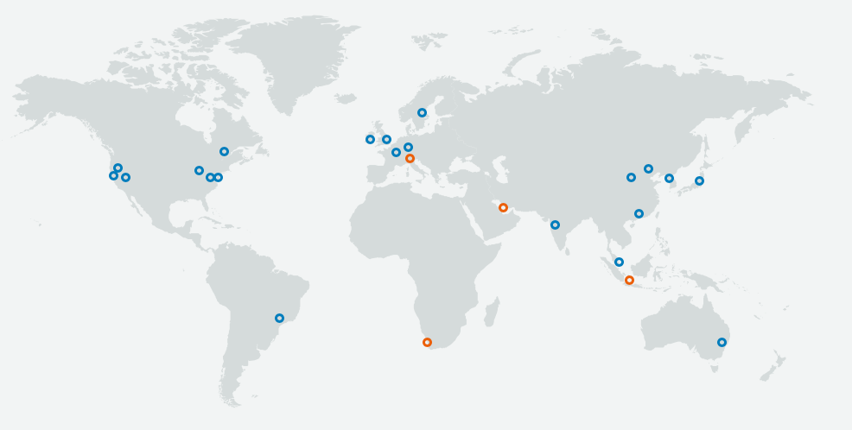
AWS Network of Regions
66 Availability Zones in 21 geographic regions, with
(12 more AZ and 4 region coming soon)

Slide 36
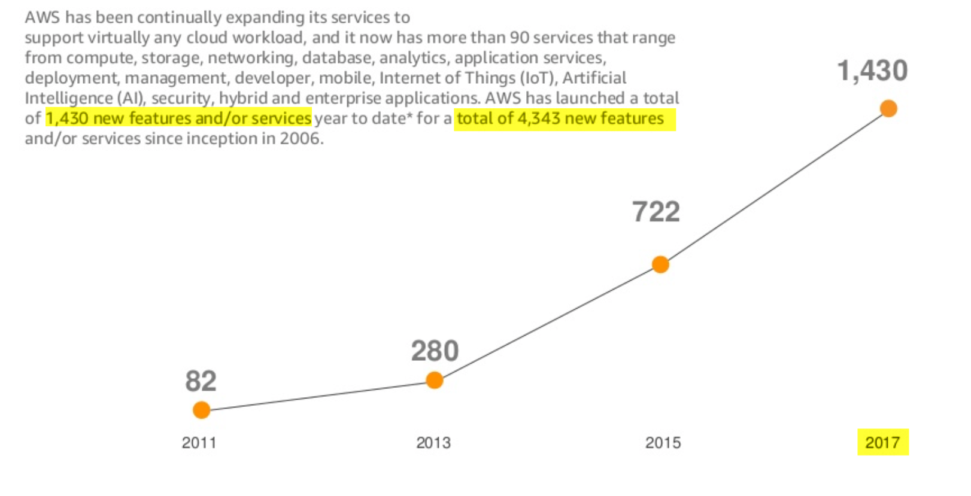
AWS Services 2017

Slide 37
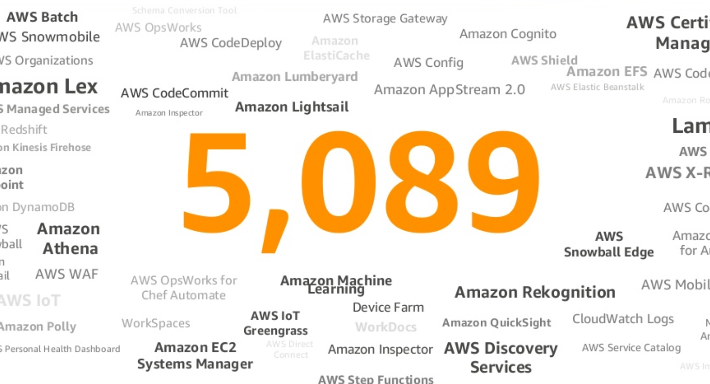
AWS Total S&F YTD

Slide 38
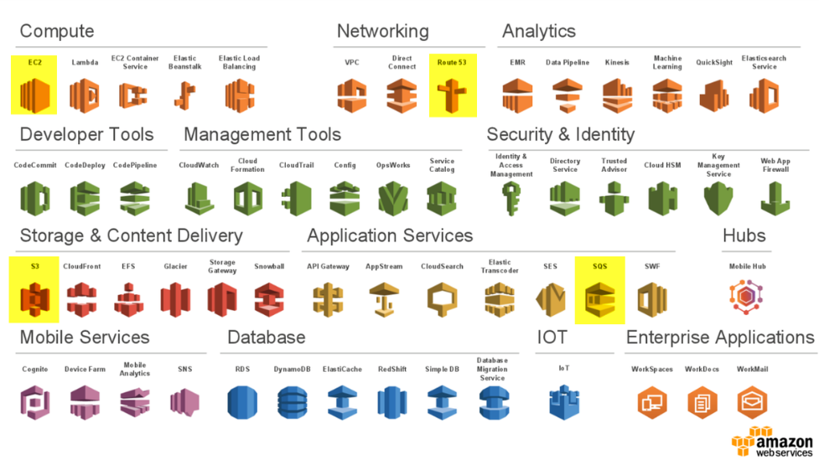
AWS Regular Services

Slide 39


AWS Pipelines
Helps you ETL between different components
Create complex data processing workloads:
Fault tolerant
Repeatable
Highly available
Pipeline
Glue

Slide 40
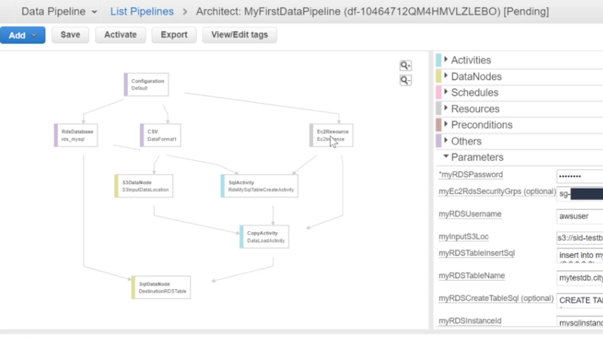
AWS Pipelines
Pipeline example in Architect view:

Slide 41
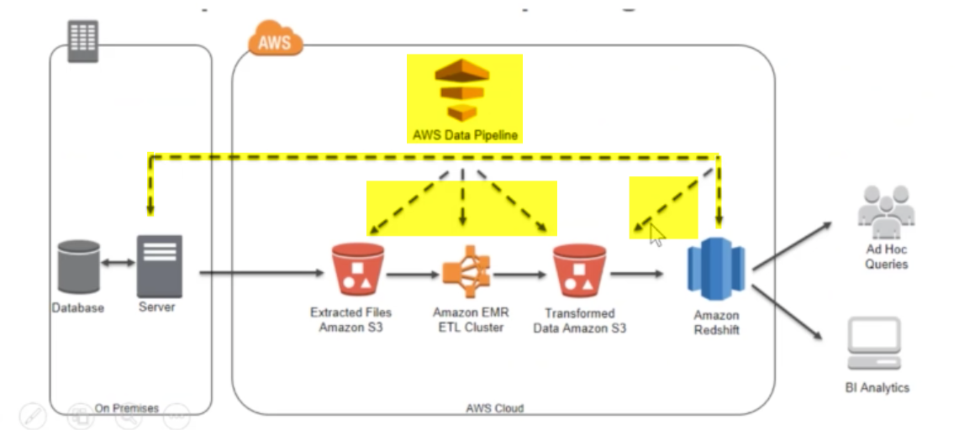
AWS Pipeline Usecases
Pipeline to automate analytics workflow

Slide 42
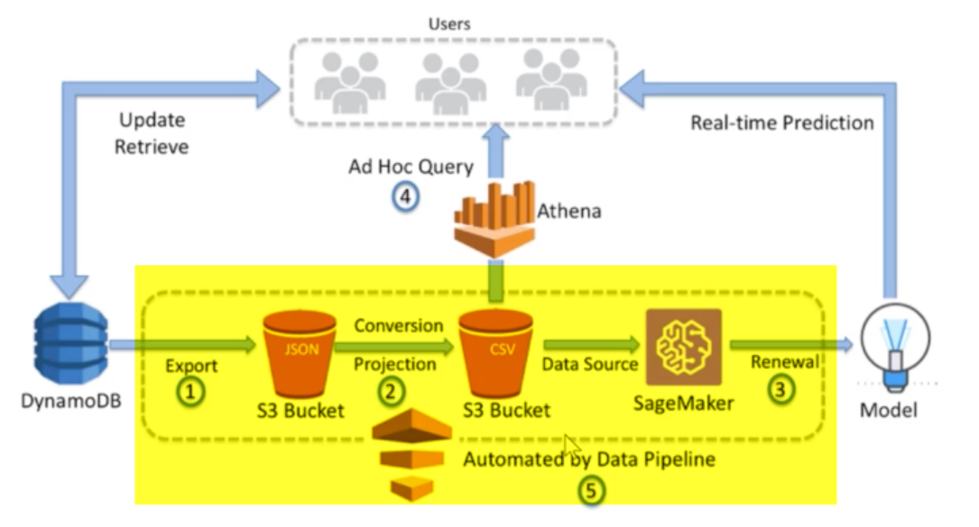
AWS Pipeline Usecases
Pipeline of DynamoDB & Sagemaker for realtime predictions

Slide 43
AWS Pipelines
Pricing:
Activities run or preconditions checked:
High Freq. Low Freq.
on AWS $1.00/mth $0.60/mth
on-premise $2.50/mth $1.50/mth
Eg: A daily job (LF) run on AWS to replicate an DynamoDB table to S3 would cost $0.60/mth. If an EC2 activity was added to this same pipeline to produce a report based on the data in Amazon S3, the total cost of the pipeline would be $1.20/mth (2 X $0.60 per activity per month).
If the pipeline was changed to run every 6 hours, it would cost $2.00/mth, because it would then consist of two High Frequency activities (at $1.00 per month for each activity).
EC2, EMR, S3, RDS, DynamoDB, SNS associated with AWS Data Pipeline are billed separately

Slide 44
AWS Pipeline for GS
Assuming customers have datasets to analyze
Customer installs AWS Task Runner on-prem DBs
GS AWS Pipeline will ‘poll’ data for extraction
Ingest customer data in S3 bucket
Or use DMS to replicate database to AWS

Slide 45
AWS Data Services
3) Catalog, Search, Process, Query, Reports
Data Files: Data Pipeline/ Glue
Data Streams:
Databases: Red Shift datawarehouse
Data Servers:
Data Messages:

Slide 46

AWS Redshift
Amazon’s fully managed data warehouse
Extremely fast:
Massively parallel process (MPP) – using slices
Columnar storage – reduces disk I/O
Data compression – columns in memory
Caches Results – code & queries
Compiled code – shared across cluster
Encryption – immutable, one way
Durability – data copied on all nodes

Slide 47
Redshift – Cluster Sizing
Considerations:
How much data you plan to import into RS?
How complex are the queries you plan to run?
How many users downstream running queries?

Slide 48
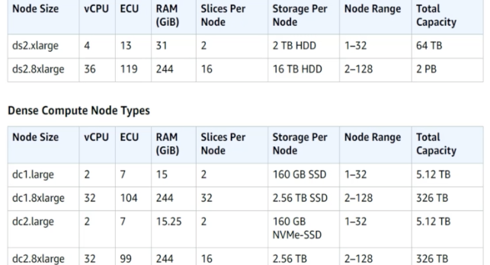
Redshift – Cluster Sizing
Notes:
Start small with 1-4 small dc1.large instances
Add more as needed
Don’t use in production right away

Slide 49
Redshift - Costs
New accounts – 750 hours/month (over all nodes)
Similar to running DC2.Large, 160GB SSD continuous
Good for testing or sizing your workload
Will use up faster if you run more nodes

Slide 50
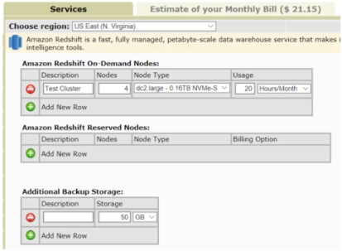
Redshift - Costs
Running 4 node RS cluster:
For 20 hrs/mth ~ $21
For full 1 month (30 days) ~ $750

Slide 51
Q&A

Slide 52




Slide 55
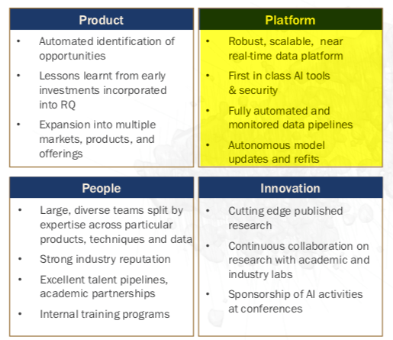
GoldSpot RQ Team

Slide 56
GoldSpot RQ Team
Desire to have a platform:
Scalable data warehousing
Cloud-compute technology
Traditional & alternate data
Automated pipelines
Robust Model Governance

Slide 57
GoldSpot RQ Team
Desire to have a platform:
Scalable data warehousing
Cloud-compute technology
Traditional & alternate data
Automated pipelines
Robust Model Governance

Slide 58
Process Dataset
Provide suggestions how to process dataset
Follow a standard ETL process
Step 1: Extract
csv files
json files
XML files
SQL DBs
Text files
APIs – tweeter, facebook, pinterest

Slide 59
Process Dataset
Step 2: Extract (80-90%)
Transform data
combining data from different sources
data cleaning
data types
parsing dates
file encodings
missing data
duplicate data
dummy variables
remove outliers
scaling features

Slide 60
Process Dataset
Step 3: Load
send the transformed data to a database
Step 4: ETL Pipeline
code an ETL pipeline (out of scope)

Slide 61
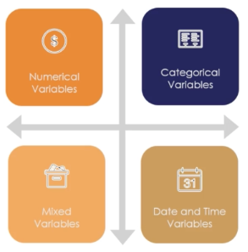
Variables
Types of variables
Numerical, categorical, dates, mixed
Types of problems
Missing values, rare values
ML model requirements
Linearization, Discretization

Slide 62
Pre-processing
Missing and rare values and outliers
Traditional methods
Imputation
Generation of new labels
Categories
Dummy variables
Ordered numbering

Slide 63
Transformation
To meet the assumptions of some ML modelings
Linearization
Normalization
Discretization
Quantiles
Range
Classification Trees (advance)

Slide 64
Missing Data
3 mechanisms that lead to missing data:
MCAR - Missing Completely at Random
MAR - Missing at Random
– eg. Men disclosing weight, use gender to control
MNAR - Missing Not at Random
Notes:
Important to understand the mechanism by which missing information is introduced in a dataset
May choose to process the missing values differently
Take action to control that source
MCAR – no relation to the data missing and any other values in the dataset
MAR – there IS a relation between missing values and other variables – eg. A survey that asks gender for weight, then we might observe men are more likely to disclose weight then women
- In this situation if we proceed to use the missing variable (ie. weight) we might include others (ie. gender) to CONTROL the BIAS in the
MNAR – there is a REASON why data is missing – eg. People filling depression survey, or Financial company asks for documents to prevent fraud, then data is missing

Slide 65
Categorical Variables
Cardinality – number of labels – eg. Gender = 2
Can effect the Train and Test set
Modeling might benefit with reducing the number
Rare Labels – appear in a tiny proportion
Same effects as Cardinality
Hard to understand the role on prediction

Slide 66
Distributions
Normal, skewed, and others…

Slide 67
Outliers
Unusual or unexpected values

Slide 68
Feature Magnitude
Scale of the different features

Slide 69
AWS Data Services

Slide 70
AWS Data Services
1) Ingestion, transfer, migration, API
Data Files: SFTP Transfer, Snowball
Data Streams: Kinesis Data Stream/ Firehose
Databases: DB Mig. Service, Schema Conv. Tool
Data Servers: DataSync, Storage Gateway
Data Messages: API Gateway, IoT Core

Slide 71
AWS Data Services
2) Storage, Caching, Archival, Backups
Data Files: S3, Glacier (Vault & Archive)
Databases: RDS, DynamoDB, Neptune, DocumentDB
Data Servers: ElastiCache (Redis, Memcached)

Slide 72
Data Governance

Slide 73
Data Governance
Important Components:
Create trust in data – for end users
Transparency and Accountability for data assets
Agile & Flexible to take advantage of opportunities
Living Process – not a one time practice

Slide 74
Data Governance
Best Practices:
Building from basics - data design, definition and standardization
Build within company culture – easier compliance
Implement polices and procedures into your model - anticipate potential security issues

Slide 75
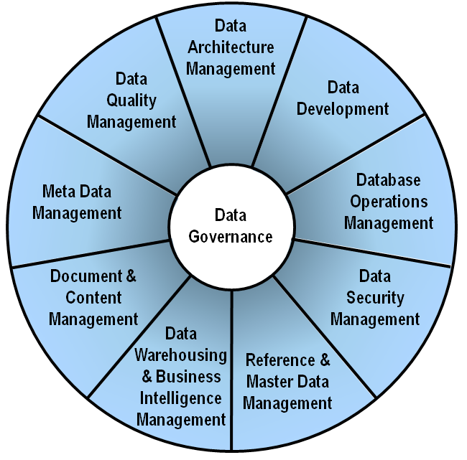
Data Modeling Is Central
Data models are at the center of Data Governance

